Slide 1
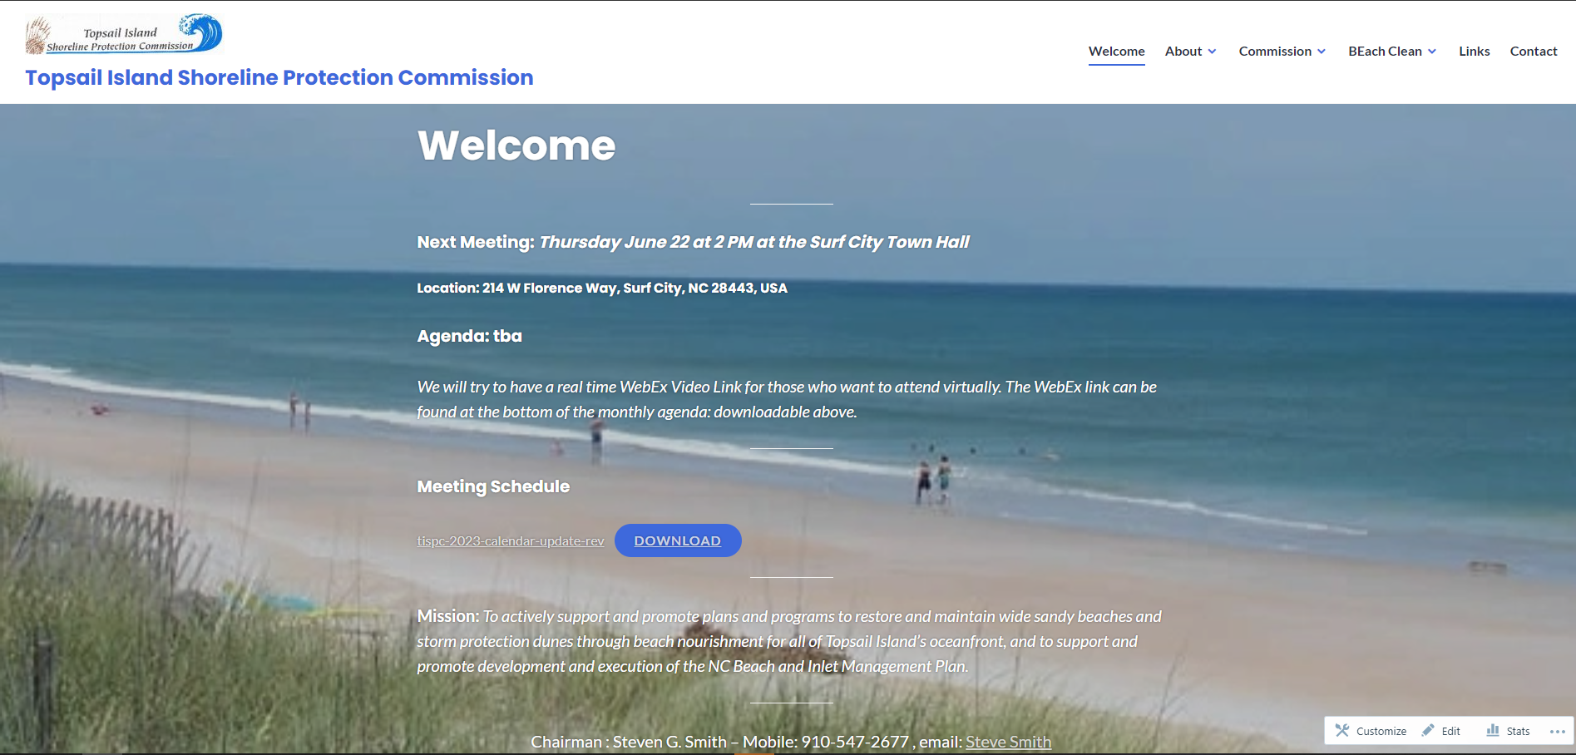
https://tispc.org/

Slide 2
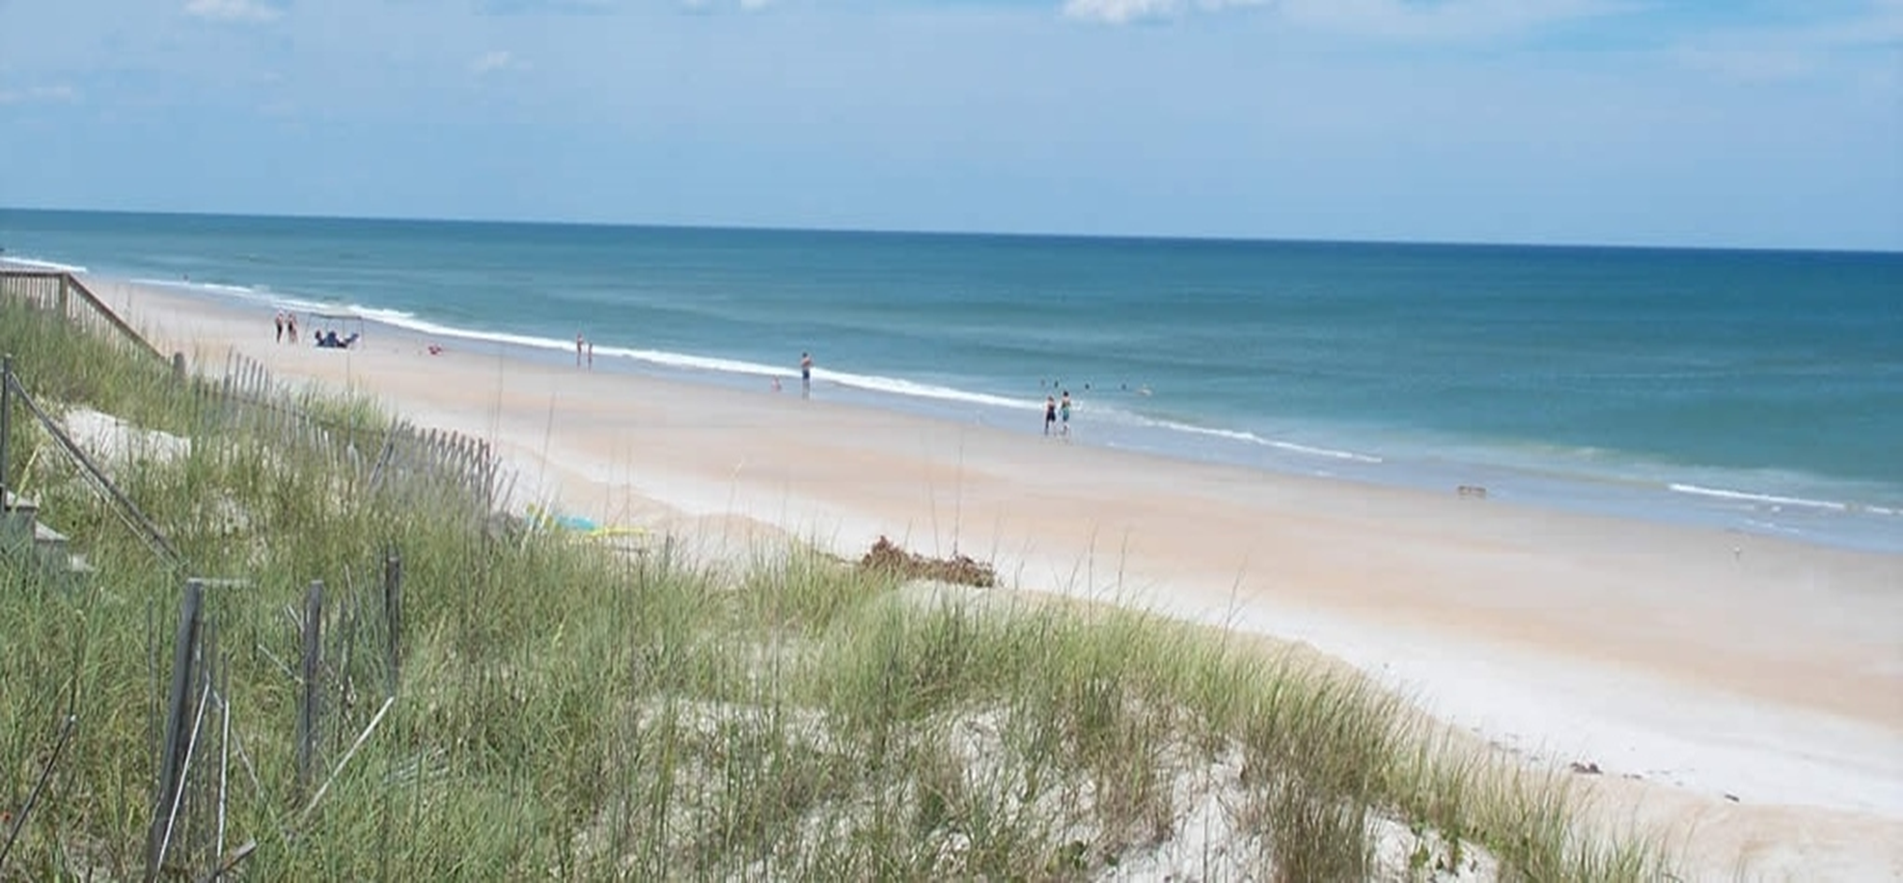
TISPC
Mission:
To actively support and promote plans and programs to restore and maintain wide sandy beaches and storm protection dunes through beach nourishment for all of Topsail Island’s oceanfront, and
To support and promote development and execution of the NC Beach and Inlet Management Plan (BIMP).

Slide 3
TISPC
Representatives
North Topsail Beach
Alderman Fontana
BISAC Chair Larry Strother
Alderman Benson (TISPC Vice-Chair)
Surf City
Mayor Batts
David Ward
Hiram Williams
Topsail Beach
Mayor Smith (TISPC Chair)
BIS Chair Snyder
BIS Member Broadhurst
Onslow County
Commissioner Price
Pender County
Commissioner George
Organization
The Topsail Island Shoreline Protection Commission is a collaborative effort for beach preservation activities by the five government entities that have authority for governing the island. These are the Board of Commissioners for Pender County and Onslow County and the governing boards for the Towns of North Topsail Beach, Topsail Beach, and Surf City

Slide 4
TISPC – April Meeting Agenda Items
Consultant & Partners Reviews
Federal Legislation Activities - Mike McIntyre
Summarized Washington Legislative trip
Sand Borrowing: CBRA zones for non-CBRA zone beach nourishment
General Reevaluation Report: Federal Project (Surf City)
NC State Legislation Activities - Connie Wilson
Monitoring bill(s) progress; Pressure on Shallow Draft Fund; Unencaps. bill
North Carolina Coastal Federation – Kerri Allen
Grant funding for oyster sanctuary & marine vessel & debris removal;
Unencapsulated polystyrene ban all 20 coastal counties;
North Carolina Beach, Inlet and Waterway Association – Kathleen Riely
Turtle Hospital – Kathy Zagzebski
Community day tour a success; Public tours starting- reservations required

Slide 5
TISPC – April Meeting Agenda Items
Old Business & Updates
a. Beach Clean Update – Realtors will promote
b. RCCP additional update/discussion – All three towns moving forward w/projects
c. Review of Washington, D.C. Discussions - See next slide
d. Balloon Ordinance Update –
Surf City & Topsail Beach adopted w/modifications; N. Topsail Beach -concerns
e. Project – Dr. Moore – Predicting Results of Resilience Projects
TISPC will support
f. CRC Meeting Review
IHA rules on hold; Septic tanks/wet sand beach; Permit fees-doubling; Shellfish structures approved; CRC CBRA/non-CBRA sand borrowing issue education

Slide 6
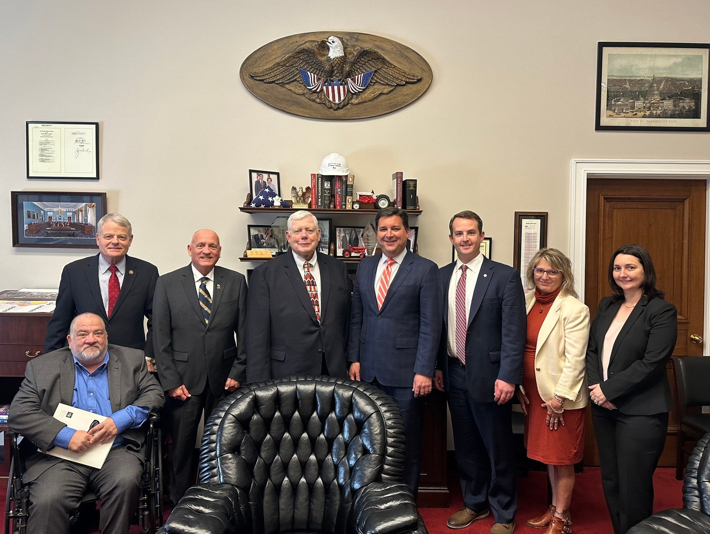
TISPC Federal Legislation Activities
Washington Trip Highlights– Mike McIntyre
NTB CBRA issue
Sand borrowing CBRA to non-CBRA
Meetings held with
Congressman Rouzer
Congressman Murphy (staff)
Senators Tillis & Burr (staff)
US Fish & Wildlife
Us Army Corps
Congressman Rouzer Meeting

Slide 7
TISPC – April Meeting Agenda Items
Town’s Local Projects/Direction
North Topsail Beach - Alice Derian
Outlined status of FEMA projects; BA4 access restored; Permit for Phase 4 nourishment; RCCP projects grant submitted
Surf City - Kyle Breuer
General Reevaluation Report: Federal Project by August; BMP with Moffatt & Nichol
Topsail Beach - Doug Shipley
BIS voted fall/winter dredging project; Outer Bar dredging with Merritt; Stormwater grant approved; Arbitration with FEMA for re-imbursement; RCCP grant failed

Slide 8
TISPC
Questions?

