Slide 1
NCEM Disaster Relief and Mitigation Grant
Town OF NORTH TOPSAIL BEACH

Slide 2
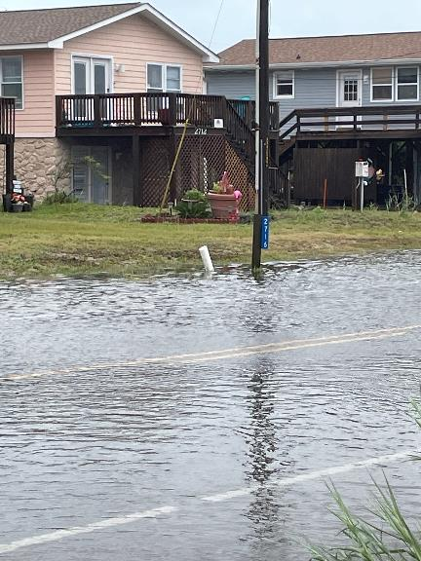
NC Resilient Coastal Communities Program
Three Topsail Island Communities participated through Phases 1-3
To identify and develop mitigation options
North Topsail Beach looked to stormwater management grant opportunities
Nine roadway sites had been identified in NTB
Island Dr. Aug 2023

Slide 3
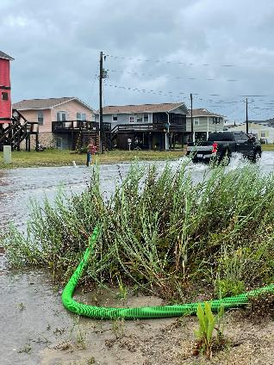
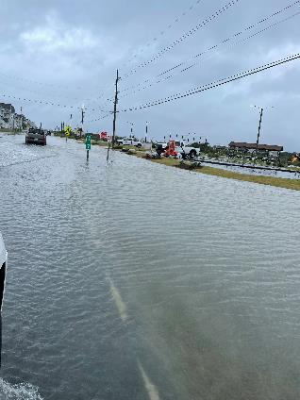
NCEM Disaster Relief and Mitigation Grant
NTB awarded a $1.2 million grant
Two critical sites of nine identified and included in grant application
One site on Island Dr. (Hwy 210): 6 mi throughfare for island-wide access (South)
Second site on New River Inlet Rd. (SR1568): serves 5 miles of the community (North)

Slide 4
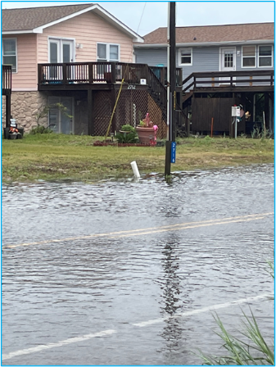
Island Dr. (Hwy 210) at Gray Street
Flooding occurs with heavy rain
Roadbed in this section below right-of-way grade
Frequent detour required
Town pumps water off

Slide 5
Island Dr. Infiltration Project: Highlights
Four stormwater inlet structures, collecting stormwater in the low point of roadway
984 ln ft stormwater pipe, conveying stormwater towards a storage structure
6,701 sq ft underground stormwater storage structures for storage and dispersion
One pump station to bring stormwater from a lower elevation on the roadway to the stormwater storage structure at a higher elevation

Slide 6
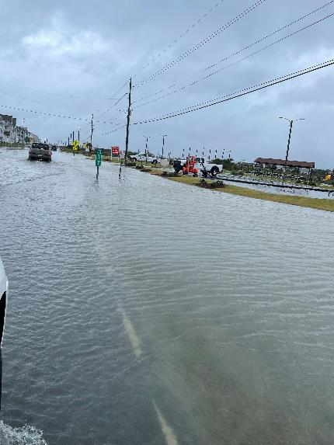
New River Inlet Rd @ Richard C. Peters Park
Flooding occurs with heavy rain
Runoff from OC Beach Access #4 and Park parking lots
Roadway in this section low point
Bioswales capacity in Park right-of-way not sufficient for heavy rains

Slide 7
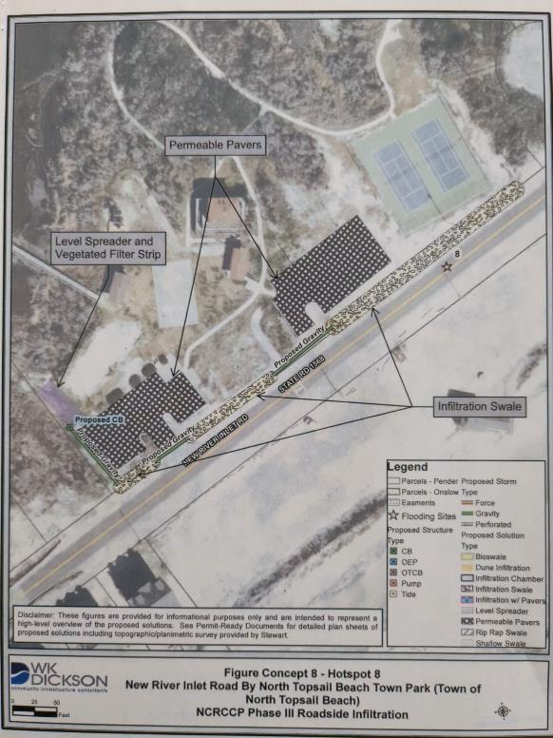
New River Inlet Rd (Park): Highlights
1,717 sq yd permeable pavers to replace the impermeable parking lot pavement
343 ln ft stormwater pipe to convey the stormwater from the shallow bioswales to a level spreader at the south of the property
386 cu yd earthwork for infiltration swales to lower the ground adjacent to the roadway and provide a location for the stormwater to collect and move toward the level spreader.
-20 linear feet of a level spreader and, one stormwater inlet structure

Slide 8
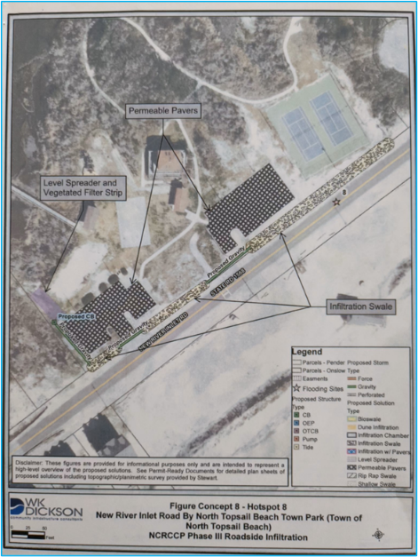
NCEM Disaster Relief and Mitigation Grant
Timeline (est.)
Grant Award Notification: April 2024
Administrative Grant Compliance: May 2024
Period of Performance: July 2024 – June 2027

Slide 9
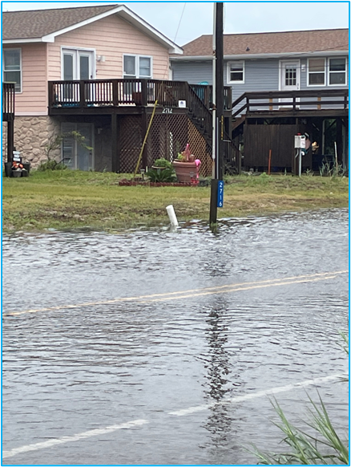
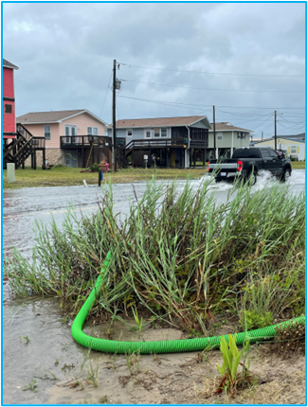
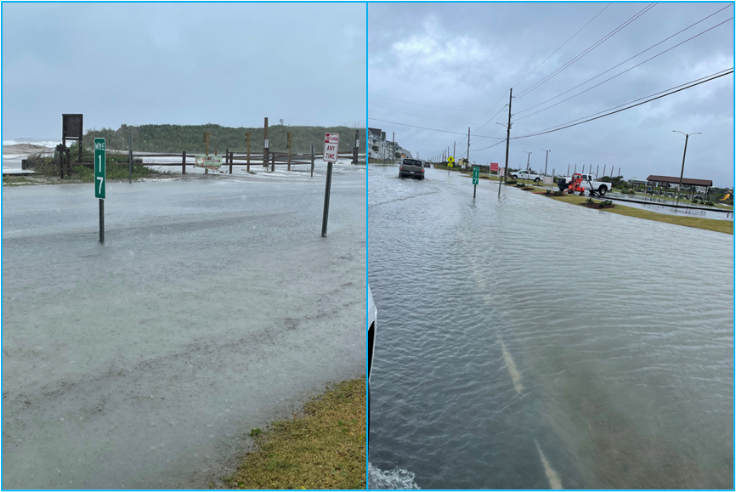
Questions?

